Slide 1
To be free or not to be free: The down side of Killer whales in captivity
By Tristan hodge

Slide 2
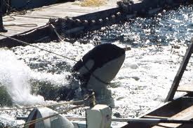
Why is it important to not capture a Whale thriving in the wild?
~ Killer whales are very intelligent creatures who's whole life revolves around the close nit family bonds.
~Whale depend on the social structure of the pod( family) when they are put into captivity they are put in with other whales who do not “speak” the same dialect, thus causing fights and stress in the whales not being able to escape
~ Back in the 60s and 70s whales were captures by marine “cowboys”. These cowboys would capture the whales they wanted and kill their families traumatizing the whales. For example Tillikum the killer whale known for killing 3 people.
~ Being put into captivity shortens the whales life span. In the wild killer whales can live up to 80 years. In captivity the max life span seems to average 20years

Slide 3
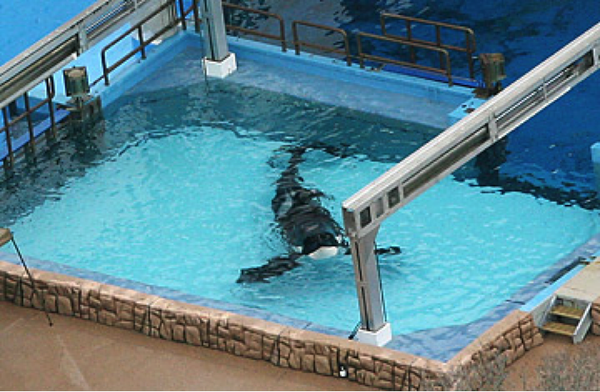
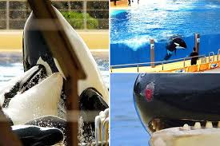
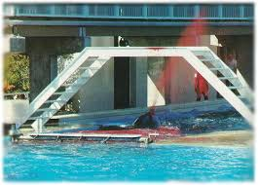
Why are Killer whales not Adapted to captiity?
In the wild killer whales swim up to 100 miles a day. Putting a whale in a tank is like putting a whale in a bathtub in order to get the proper amount of exercise they would have to swim 3105 laps back and forth the length of the tank and 1,208 laps around the perimeter of the tank
in marine parks the killer whales live in such small an shallow tanks. When there is a fight between whales there is no where for the whale being attacked to escape .
Mentally the stimulation is not adequate for such intelligent animals. IN the wild they are always hunting , playing and exploring.

Slide 4
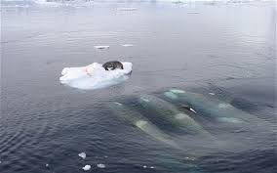
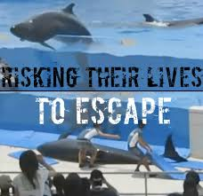
Why is a killer whales intelligence problematic to a life in captivity?
~ When Killer whales hunt the work together and coordinate the best way of catching their prey as a team in captivity they are not given this freedom to truly think and be mentally stimulated.
~ Researchers have come to find that the cerebral hemispheres- the area of the brain believed to deal with advanced mental process in humans- are exceptionally well developed in orcas.
~ when a whale is put into captivity ( tanks the size of a bath tub ) it is known to have ill effects , whales bashing their heads on metal gates, depression and ulcers, to even jumping out of the tanks in a form of suicide.
~ killer whales are known to have declarative knowledge, as well as procedural, social and self knowledge making them them highly intelligent and aware of the world around them

